Slide 1

Eclipse for Java
- About the Author

Slide 2
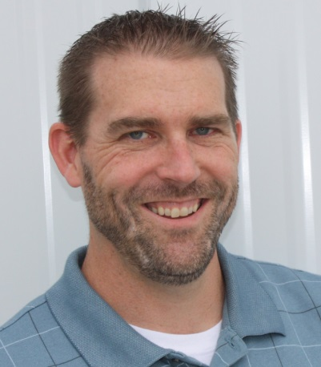
Brian Gorman
12 + years programming experience
B.S. Computer Science
M.S. Computer Information Systems
5 + years of online computer science instruction
MCSD Certified C#.Net

Slide 3
Have instructed courses or built training modules in
Java Programming
Algorithms and Design Patterns
JSP/Servlets
C#.Net
VB.Net
SQL Server
Microsoft Office
Bootstrap
HTML

Slide 4
I hope you learned a lot from our course
All feedback is welcome and appreciated!
Linked In: please mention Infinite Skills, Eclipse for Java, or something similar in the notification if you would like to connect with me: http://www.linkedin.com/in/brianlgorman

